Slide 1
Strategy for using SRS to achieve acting learning in Business & Marketing subjects
V2018.03.07
(with sample LESSON IN VIRAL MARKETING)
By Adam wong & Jacky Wong

Slide 2
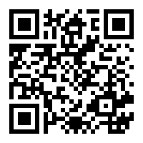
Pre-Induction Questionnaire
Get a feel of student’s perspective of using Socrative
Complete the survey at www.socrative.com
  Use student login. No password required.
  Room is JACKYWONG
Don’t give a QR code unless the link is very long

Slide 3
Attendance (Sample)
There is no need to sign the attendance list.
Your answers in the SRS counts towards your attendance / participation.
Make sure your name do not duplicate with another student.
No marks will be deducted for wrong answers. So always use your name.

Slide 4
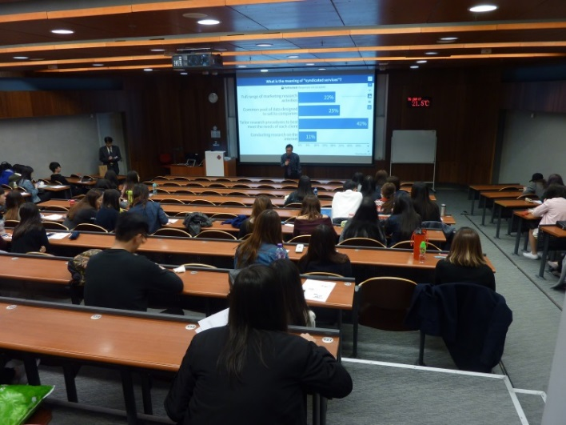
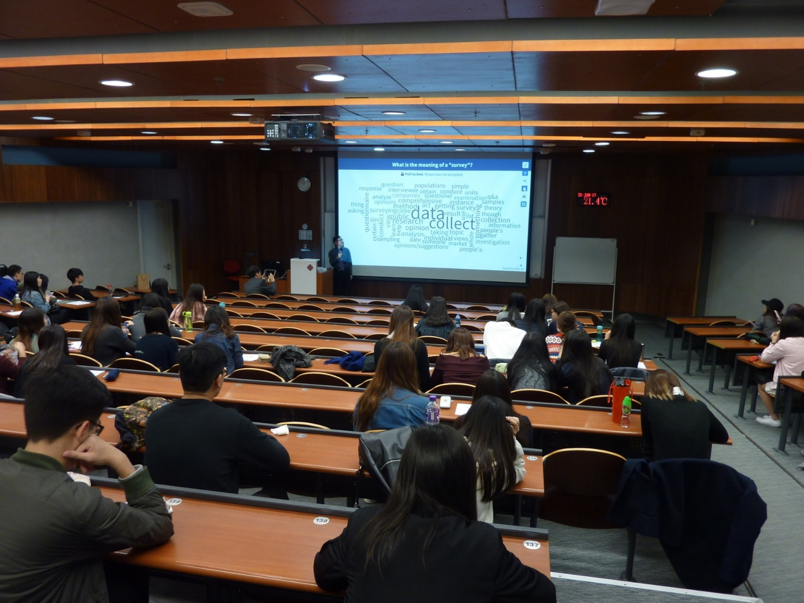
A typical class, or not?

Slide 5



Use the Right SRS at the Right Time
Kahoot.com
No installation
Game-like
MC question only
Automatic scoring
Socrative
No installation, no password
Fewer question types
Easy to operate
Poll Everywhere
CPCE single-sign on required
MC, Open-ended +...
Optional installation

Slide 6
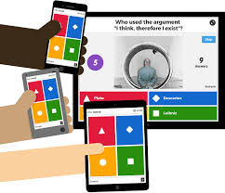
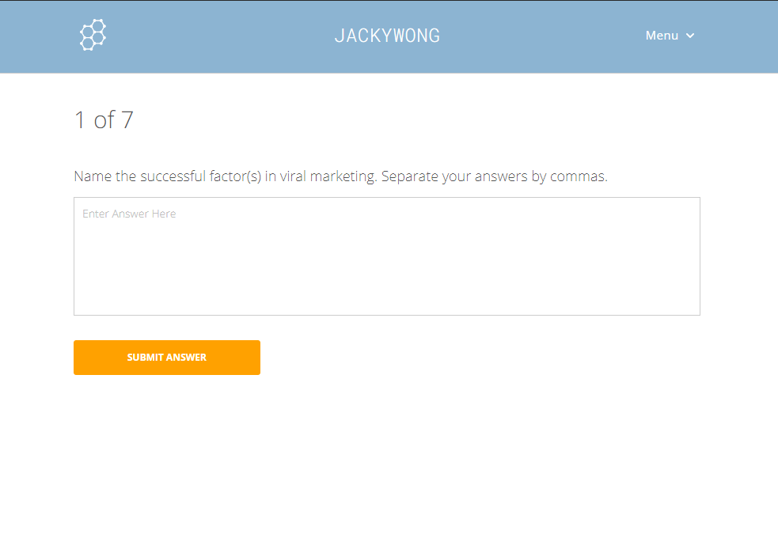
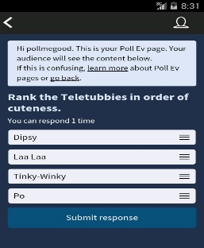
Quick Comparisons
SRS | Kahoot! | Socrative | Poll Everywhere
Image
Question Type | MC | MC, Short Answers, TF | Mc, Short Answers, Ranking, Images
Anonymity | Yes | Yes (optional login) | No
Grade | Automatic (Accuracy + Time) | Yes | Optional
Timer | Always on | Not available | Optional
Charts/Reports | Only leader board | Yes | Charts, Word Cloud….
PowerPoint Insertion | As URL links | As URL links | As slides

Slide 7
The Motivate/Gateway/Consolidate Strategy
SUBJECT
Purpose
& Role
Revision
1
2
3
4
5
6
7
8
9
10
11
12
13
LECTURE
(2hrs)
Recap
1-2 poll(s)
Motivate
1 poll
Gateway
Poll-
Discuss-
Poll Again
Consolidate1-2 poll(s)
3mins
5mins
10 mins
5mins
TUTORIAL (Video/Case Study)
Fact Check
Reflect

Slide 8
The Poll-Discuss-Poll-Again (PDP) Approach
(a.k.a. “Double Click” )
Students try the problem on their own first, then register their answers with their mobile phones (first click).
Do not reveal the distribution of their first individual clicks immediately.
Ask students to work together and then poll again.
Do not reveal the distribution of the second clicks immediately.
Ask if some students changed they mind and why.

Slide 9
Sample lecture – Viral Marketing
Actual slides taken from SPD4513 E-Commerce Strategy & Implementation

Slide 10
Learning objectives
Understand the essence of the definition of VM
Describe the nature of viral marketing (VM)
Compare VM approaches used by marketers
Evaluate the advantages and disadvantages of VM
Explain the critical success factors for a successful VM campaign
Please answer at socrative.com
Use student login. No password required
Room: JACKYWONG

Slide 11
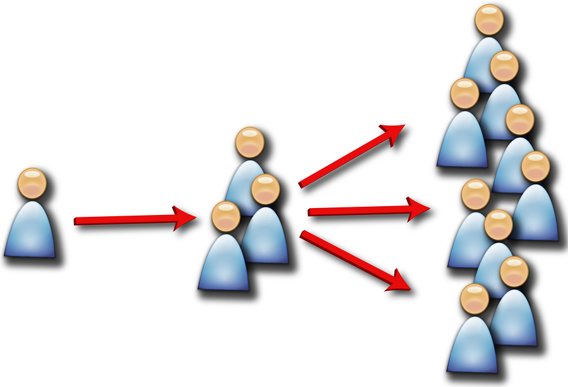
Viral marketing

Slide 12
What is Viral Marketing?
Definition: It is the transmission of marketing messages through various Internet-based channels by peers.
During these transmissions, information passes between individuals without the involvement of the original message source.
The message spreads like a virus would spread, hence the name, viral marketing.
Other names:
electronic word-of-mouth (e-WOM)
“buzz marketing”, word-of-mouse

Slide 13



Three VM Examples
Guess which of the following viral marketing videos get the most views.
  It All Starts With You - Oxfam
  Fala Chen ALS Ice Bucket Challenge 陳法拉冰桶挑戰
  Chris Evans - 22 Push-Up Challenge
Please answer at socrative.com
Use student login. No password required
Room: JACKYWONG

Slide 14
Viral Marketing - Principle & Components
Basic principle:
  Give people a reason to talk about your products and services, and make it easy for them to do so.
Components:
  Viral Agent: the message to be transmitted (a.k.a "the seed")
  Viral Campaign: the structure and management of the whole activity
Viral agents can take one of the following forms
  Text message, video, TV advertisement
  Cartoon, funny picture
  Poem, Song (e.g. The EBay Song)
Notes:
The “eBay Song” is a parody of "I Want It That Way" By the Backstreet Boys)
eBay Song
(http://www.youtube.com/watch?v=jCIp7eo4MvY)
eBay Song Lyrics
(http://www.youtube.com/watch?v=UW9bHDy5khQ)
“Backstreet Boys - I Want It That Way”
http://www.youtube.com/watch?v=4fndeDfaWCg

Slide 15
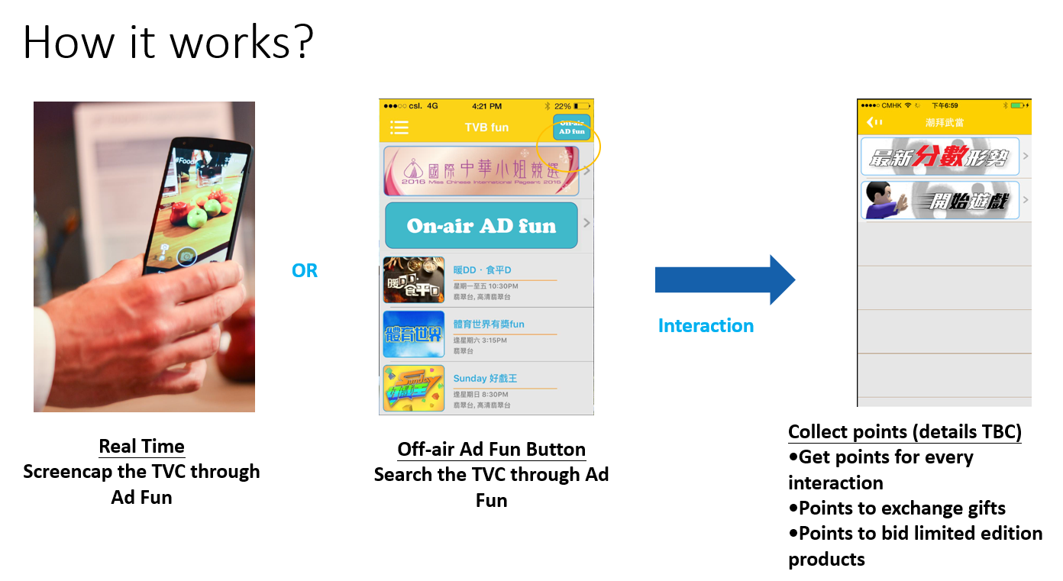

Quiz
(I skipped 3 slides. This is a gateway quiz.)
Is "Ad Fun" a form of viral marketing?
Please answer at socrative.com
Use student login. No password required
Room: JACKYWONG

Slide 16
Consolidate Quiz
(I skipped 11 slides. This is a consolidation quiz.)
In the definition for VM, what is the one word that differentiate it from other forms of promotion?
Please answer at socrative.com
Use student login. No password required
Room: JACKYWONG

Slide 17
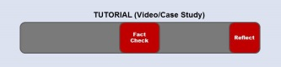


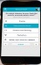



Tutorial (Video/Case Study)
After first three minutes:
What is the name of the company?
Name the cost concepts involved here?
Near the middle:
Name the three solutions suggested by the consultant
Before revealing the ending:
What solution do you suggest to the company?
Reveal results → Discuss (see "Double Click" in next slide)
Poll Again
Reveal the ending
Teacher’s wrap-up

Slide 18
Tips
Avoid having 7 polls or more.
Use polls to get students to discuss and think.
Play safe - polls in pairs in case PDP is needed.
  Avoid memory tests or notes fill-in-the-blanks, unless you are really doing a test.
Before you lock/stop the poll, ask if anybody needs more time.
Invite students to justify their answers.
  Don't jump ahead to explain the answers.
  Students learn more from peers.
Predict possible answers.
  Be prepared to explain why the answer(s) is/are right/wrong.
Control polls and show results using your tablet.

Slide 19
Resources
MyPollEv.com
Experience sharing with Adam Wong, Eric Woo and Simon Wong
During Semester Two of 2017/2018, you can get the following support via project research assistant Jacky Wong (x 0081).
  Pre-class Support
    Help to use the SRS
    Create questions for you
  In-class Support
    Help to administer the polls
    Help students with SRS (less than 5% of them need help)
  Post-class Support
    Archive results
    Generate reports

Slide 20
Post-Induction Questionnaire
Complete the survey at www.socrative.com

Slide 21
Experience Sharing & Research Ideas
Use SRS for quizzes + Survey + Compare with previous cohort
Response time vs. Performance
Attendance vs. Performance
Anonymity vs. Identifiability

Slide 22
The End

