Slide 1
Strategy for using SRS to achieve acting learning
V2017.12.01 (lite)

Slide 2
Pre-Induction Questionnaire

Slide 3
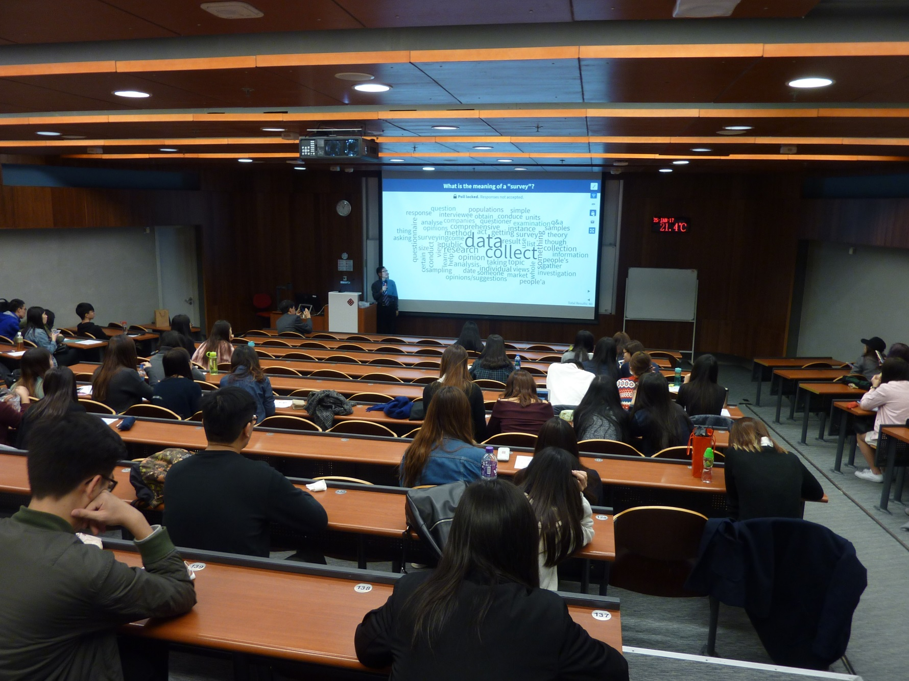
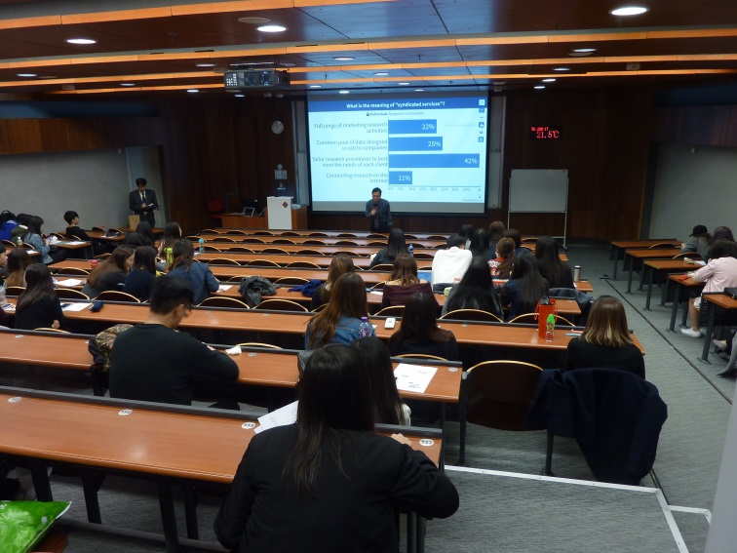
A typical class, or not?

Slide 4
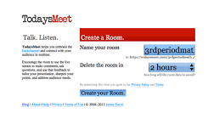


Examples of SRS
TodaysMeet.com
Web.WhatsApp.com minus Phone #
Open-ended questions only
Website-based
No app installation
Example: https://todaysmeet.com/CPCE *
Kahoot
Game-like (background music)
MC questions only
Website-based
Example: [ to be inserted here ]
Poll Everywhere
Versatile (MC, Open-ended, Rank + ...)
Website-based
* Available until 31 Dec 2017

Slide 5
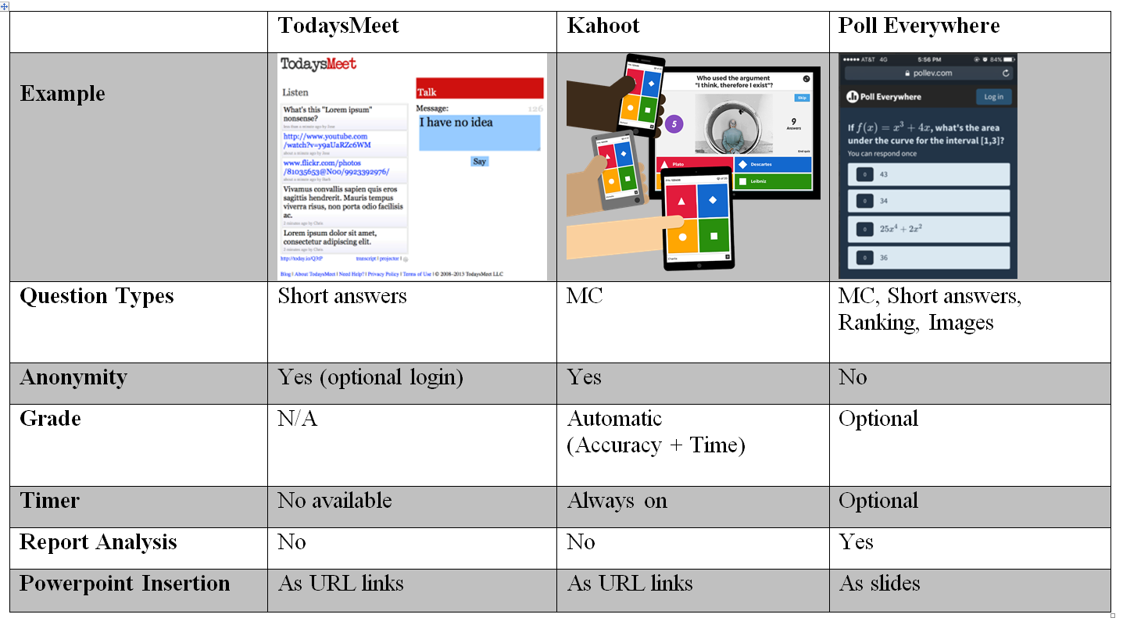
Quick Comparisons

Slide 6
The Motivate/Gateway/Consolidate Strategy
SUBJECT
Purpose
& Role
Revision
1
2
3
4
5
6
7
8
9
10
11
12
13
LECTURE
(2hrs)
Recap
1-2 poll(s)
Motivate
1 poll
Gateway
1 poll
Discussion
Repoll
Consolidate1-2 poll(s)
3mins
5mins
10 mins
5mins
TUTORIAL (Video/Case Study)
Fact Check
Reflect

Slide 7
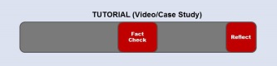


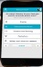



Tutorial (Video/Case Study)
After first three minutes:
What is the name of the company?
Name the cost concepts involved here?
Near the middle:
Name the three solutions suggested by the consultant
Before revealing the ending:
What solution do you suggest to the company?
Reveal results → Discuss (see "Double Click" in next slide)
Poll Again
Reveal the ending
Teacher’s wrap-up

Slide 8
The “Double Click” Approach
Students try the problem on their own first, then register their answers with their mobile phones (first click).
Do not reveal the distribution of their first individual clicks.
Ask students to work together and then poll again.
Do not reveal the distribution of the second clicks.

Slide 9
Tips
Use polls to get students to discuss and think.
Before you lock the poll, ask if anybody needs more time.
Invite students to justify their answers.
  Don't jump ahead to explain the answers.
  Students learn more from peer.
Predict possible answers.
  Be prepared to explain why the answer(s) is/are right/wrong.

Slide 10
Resources
MyPollEv.com
Experience sharing with Adam Wong, Eric Woo and Simon Wong
During Semester Two of 2017/2018, you can get the following support via project research assistant Jack Wong (x 0081).
  Pre-class Support
    Help to use the SRS
    Create questions for you
  In-class Support
    Help to administer the polls
    Help students with SRS (less than 5% of them need help)
  Post-class Support
    Archive results
    Generate reports

Slide 11
The End

