Slide 1
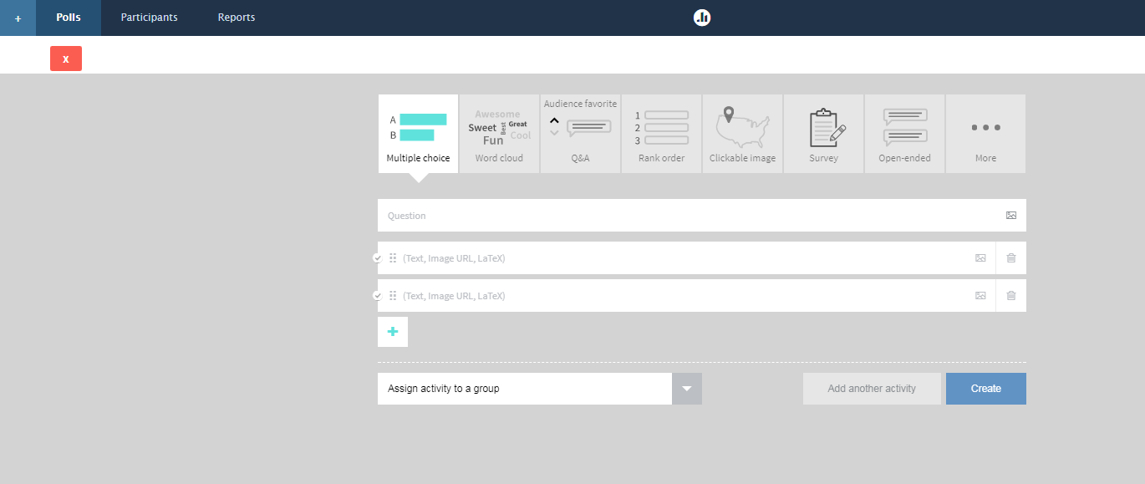
Poll Creation
Insert photo in question / choice
Mark this as a correct answer
Delete entry
Add new choice
Create poll
Group the poll into an existing group

Slide 2
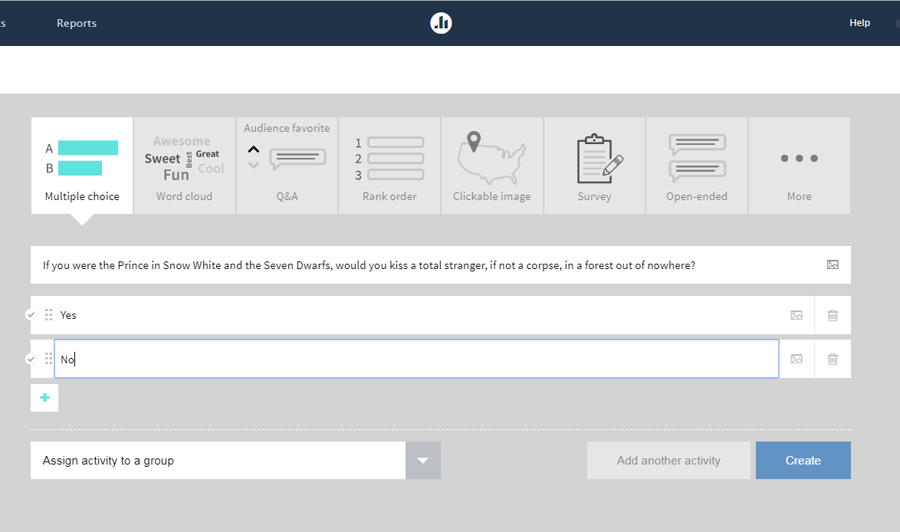

MC – No Correct Answer (Intended for Discussion)
Spontaneity
Sexuality
Royal etiquette
Hygiene

Slide 3
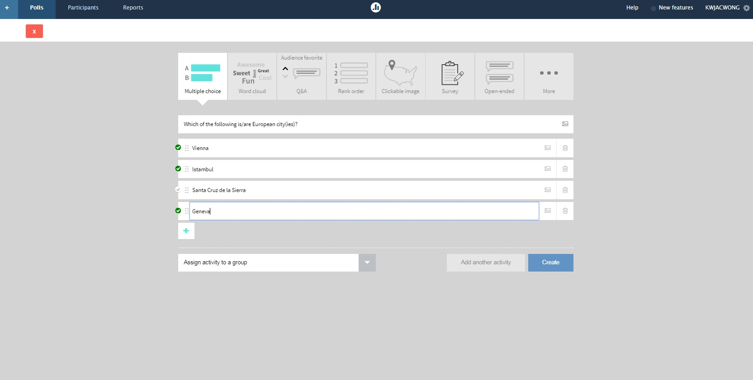
MC – (Multi) Correct Answer(s)

Slide 4
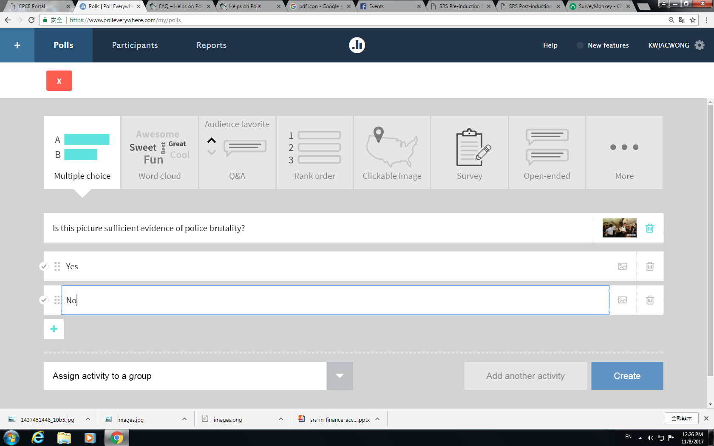
MC – Image in Question

Slide 5
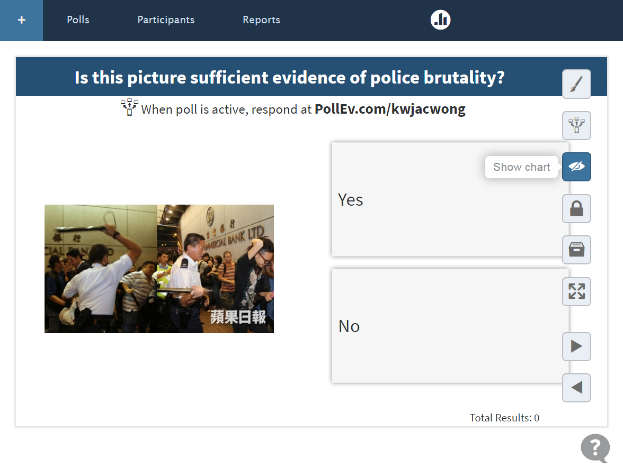
MC – Image in Question

Slide 6
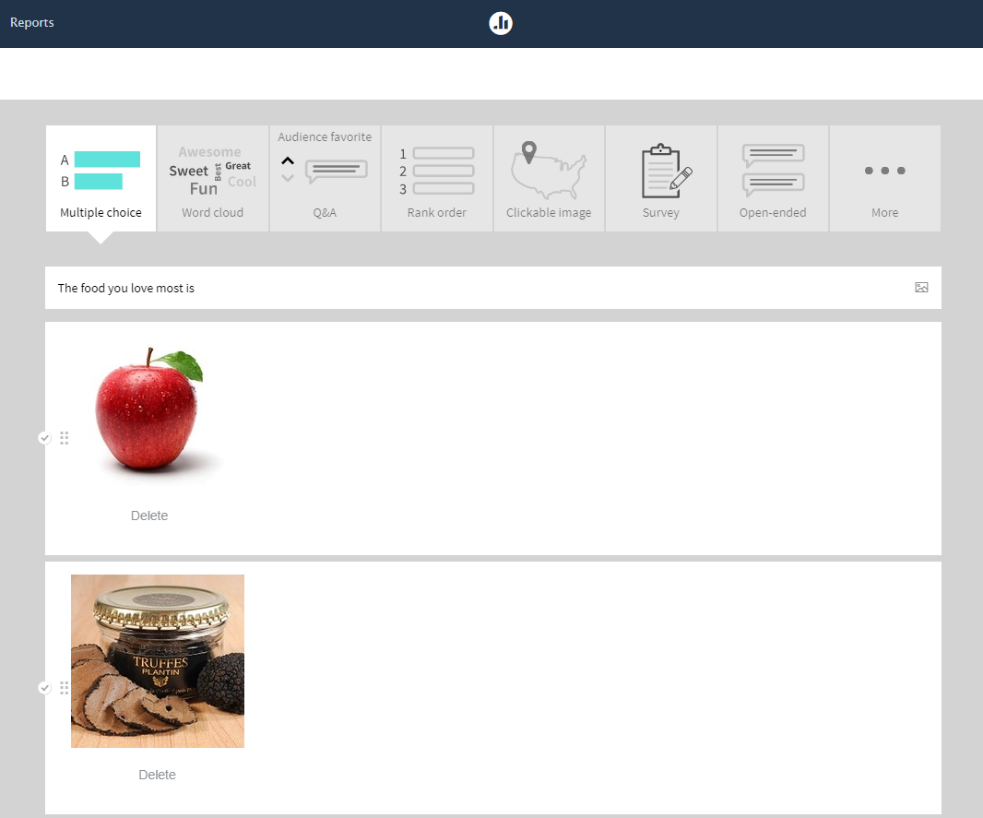
MC – Images in Answer

